Slide 1
Java8 Function
PS
Notes:
https://yuedu.baidu.com/ebook/f7c46708a26925c52cc5bff4.html?f=read

Slide 2
Programming Paradigm
Function Programming Paradigm
Object Oriented Programming Paradigm
Aspect Oriented Programming Paradigm
Notes:
编程范式

Slide 3
OOD Principle
Single responsibility principle
Open close principle
Liskov substitution principle
Interface Segregation principle
Dependency Inversion principle
Law of Demeter
CARP
Notes:
OCP- Open close principle
ISP – Interface segregation principle
CARP - Composition aggregation reuse principle
LSP – Liskov substitution principle
LoD - Law of Demeter
SRP - Single responsibility principle
DIP – Dependency Inversion principle
开口合里最单依

Slide 4
OOD Principle
If we follow all the principles of OOD, we would get MANY interfaces only have one method. We DO NOT like it.
We could wrap them with function.? 不懂

Slide 5
Function first
Function can be the return value of another function

Slide 6
No side effect
Side effect means it won’t change the outer state, such as a global variants.
Notes:
函数的副作用是指，它除了给出返回值外，还修改了函数的外部的状态。

Slide 7
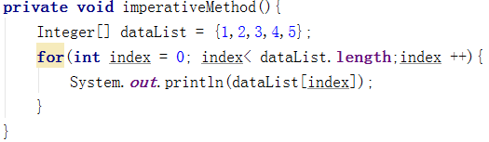
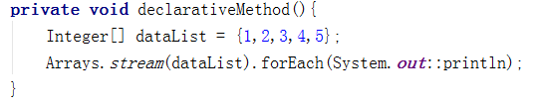
Declarative & Imperative Programming
Notes:
Declarative programming: 声明式编程
Imperative Programming： 命令式编程

Slide 8
尾递归优化
Disadvantage of recursion programming: it may cause stackOverflow.
尾递归优化可以很好解决这个问题。
Notes:
尾递归指递归操作位于函数的最后一步。在这种情况下，该函数的工作其实已经完成（剩余的工作就是再次调用它自己），此时只需要将中间结果传递给后继调用的递归函数即可。
此时编译器就可以进行优化，使当前的函数调用返回，或者用新函数的栈帧覆盖老函数的栈帧。
当递归操作位于函数的最后一步时，我们就可以避免递归操作不断的申请栈空间。
大部分函数式编程语言都直接或间接的支持尾递归优化。

Slide 9
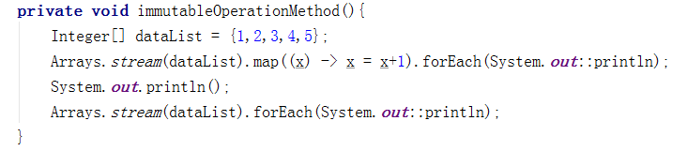
Immutable Pattern
For it is immutable, then it’s easy to run parallel

Slide 10
Less code
Less code, easy for maintain

Slide 11
@FuncationalInterface
Conceptually, a functional interface has exactly one abstract method.
If one interface follows definition of @FuncationalInterface without @FuncationalInterface annotation, compiler will consider it as a funcational interface, just like @Override.
If one interface doesn’t follow definition of @FuncationalInterface with @FuncationalInterface annotation, compile will raise an exception.
It could have default method, and methods implemented by java.lang.Object

Slide 12
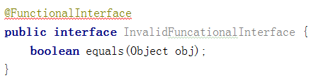
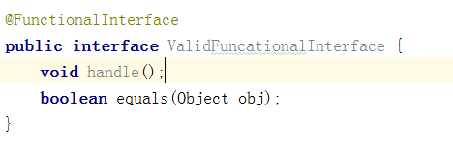
@FuncationalInterface

Slide 13
Lambda expression
Lambda expression is anonymous method.
和匿名对象一样Lambda表达式也可以访问外部的局部变量，外部的局部变量必须申明为final.
Java 8自动将外部的局部变量视为final, 若在Lambda表达式中对其做更改将会报错。

Slide 14
Method reference
静态方法引用： ClassName::methodName
实例上的实例方法引用： instanceReference::methodName
超类上的实例方法引用： super::methodName
类型上的实例方法引用： ClassName::methodName
构造方法引用： Class::new
数组构造方法引用：TypeName[]::new

Slide 15
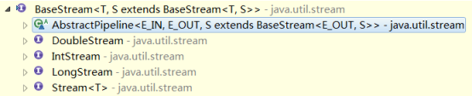
Stream
A sequence of elements supporting sequential and parallel aggregate operations.

Slide 16
interfaces
Predicate
DoublePredicate
IntPredicate
LongPredicate
UnaryOperator
LongUnaryOperator
DoubleUnaryOperator
IntUnaryOperator
BinaryOperator
LongBinaryOperator
IntBinaryOperator
DoubleOperator
BiConsumer
Function
IntFunction
LongFunction
DoubleFunction
BiFunction
Consumer
LongConsumer
IntConsumer
DoubleConsumer
Supplier
IntSupplier
LongSupplier
DoubleSupplier

Slide 17
Interfaces Introduction
谓词接口：用来进行条件判断，传入一个参数判断参数是否满足某个条件并进行布尔返回。
Predicate
DoublePredicate
IntPredicate
LongPredicate

Slide 18
Interfaces Introduction
单元操作接口对传入的参数进行转化，并且会返回指定数据类型的结果。
“单元”指的是只有一个参数
二元操作接口可以接受两个参数，两个入参的数据类型与返回类型相同。
UnaryOperator
LongUnaryOperator
DoubleUnaryOperator
IntUnaryOperator
BinaryOperator
LongBinaryOperator
IntBinaryOperator
DoubleOperator

Slide 19
Interfaces Introduction
函数接口（单元，二元）和操作接口（单元，二元）类似，都是接收一个或两个参数进行处理返回，但函数接口并不要求返回参数类型与入参类型一致。
Function
IntFunction
LongFunction
DoubleFunction
BiFunction

Slide 20
Interfaces Introduction
消费者接口与函数接口类似，但返回void类型。
Consumer
LongConsumer
IntConsumer
DoubleConsumer
BiConsumer

Slide 21
Interfaces Introduction
工厂接口（供应商接口），与函数接口类似但没有入参
Supplier
IntSupplier
LongSupplier
DoubleSupplier

Slide 22
ForEach
Iterator elements of a stream.
public interface Stream<T> extends BaseStream<T, Stream<T>> {
void forEach(Consumer<? super T> action);
}

Slide 23
filter
Filter and process elements of a stream.
public interface Stream<T> extends BaseStream<T, Stream<T>> {
Stream<T> filter(Predicate<? super T> predicate);
}

Slide 24
map
Returns a stream consisting of the results of applying the given function to the elements of this stream.
public interface Stream<T> extends BaseStream<T, Stream<T>> {
<R> Stream<R> map(Function<? super T, ? extends R> mapper);
}

Slide 25
reduce
MapReduce
public interface Stream<T> extends BaseStream<T, Stream<T>> {
T reduce(T identity, BinaryOperator<T> accumulator);
Optional<T> reduce(BinaryOperator<T> accumulator);
<U> U reduce(U identity, BiFunction<U, ? super T, U> accumulator, BinaryOperator<U> combiner);
}
Notes:
MapReduce:的核心思想，Map将大任务分解成小任务，将这些小任务独立运行；reduce再将小任务的计算结果聚合成目标任务的结果。

Slide 26
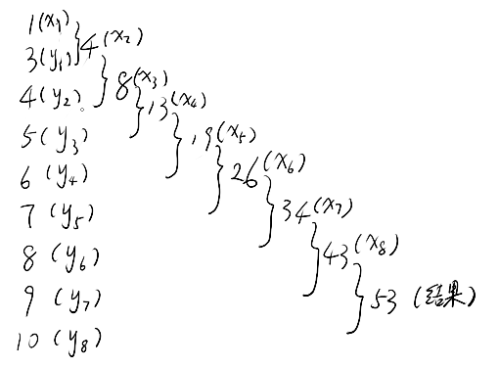
reduce

Slide 27
collect
collect data from stream to a List, Set or Map

Slide 28

peek
for debugging

